Slide 1
Prefect Application
Notes:
INTRODUCTION : Charlie

Slide 2
Thank you

Slide 3
Prefects
This is a great opportunity to take on a leadership role at CVC
You will develop some of the following skills: communication skills, approachable, organised, working as a team, working with peers and staff etc.
There are many different prefect roles on offer from Tour Prefects, Interview Prefects, Event Prefects, Yearbook Prefects, Equality and Diversity Prefects, Environment Prefect, RRS Prefect, Wellbeing Prefect
If you have already applied, you do not need to re-apply.
Notes:
Charlie

Slide 4
Roles available
Tour Prefects
Interview Prefects
Event Prefects (encompassing open and option, celebration day, winter and may ball)
Yearbook Prefects
Equality and Diversity Prefects
Environment Prefect
Rights Respecting Schools Prefect
Wellbeing Prefect
Notes:
ROLES PART 1 : Diya

Slide 5
Interview Prefects
Lead Member of staff
Head of Student Leadership
Purpose
Interview staff that would like to work at Comberton Village College
Skills to develop
Communication, Time management, Organisation and Working with others and confidentiality .
Notes:
Diya

Slide 6
Tour Prefect
Lead member of staff
Head of Student Leadership
Purpose
Touring new staff coming for interview, pupils and their parents, MPs, Staff from other schools, students and staff from other countries…..
Skills to develop
Communication, Time management, Organisation and Working with others and good knowledge of the school systems

Slide 7
Events prefect
Lead member of staff
Head of Student Leadership and & Site Managers, Mrs Roberts and Miss Cotton
Purpose
Supporting staff with planning and organisation and delivery of year 6 and 12 open evening and Year 9 options evening from stewarding, serving drinks to staff and meeting and greeting.
Supporting Mrs Roberts and Miss Cotton with the planning and organisation of the Winter Ball, Celebration day and the May Ball.
Skills developed
Organisation, Working with Mrs Roberts and Miss Cotton and outside organisations, Communication, Time management and team work

Slide 8
Yearbook Prefects
Lead member of staff
Mrs Roberts and Miss Cotton
Purpose
Create the Year book for 2025 by creating the front cover, collecting and organising photos and quotes from students and staff.
Skills developed
Team work, Organisation, Creative skills, Working with Mrs Roberts and Miss Cotton and outside organisations

Slide 9
Equality and Diversity Prefects
Lead member of staff
Miss Burns
Purpose
Promoting and developing the Equality and Diversity at Comberton Village College.
Skills developed
Teamwork, Organisation, Communication, Working with Ms Burns and outside organisations, Developing resources to promote Equality and Diversity at Comberton Village College.

Slide 10
Environment Prefect
Lead member of staff
Mr Gordon
Purpose
Promoting and developing the Environmental Issues that matter to us at Comberton Village College and the greater community and beyond.
Skills developed
Organisation, Working with Mr Gordon and outside organisations, communication, time management and team work.

Slide 11
Wellbeing prefect
Lead member of staff
Mr Beamish
Purpose
Promoting and developing the Well Being at Comberton Village College for students and staff.
Skills developed
Organisation, Working with Mr Beamish and Miss Baker and outside organisations, communication, and teamwork

Slide 12
Rights Respecting Schools Prefect
Lead member of staff
Mrs Burgess
Purpose
Promoting and developing the Rights Respecting School matters at Comberton Village College.
Skills developed
Team work, Organisation, Creative skills, Working with Mrs Burgess and outside organisations

Slide 13
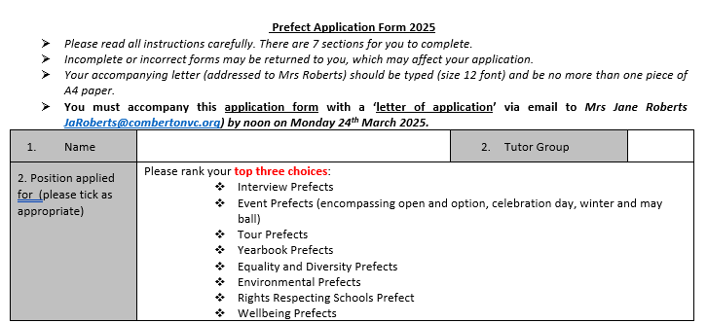
Prefect Applications

Slide 14
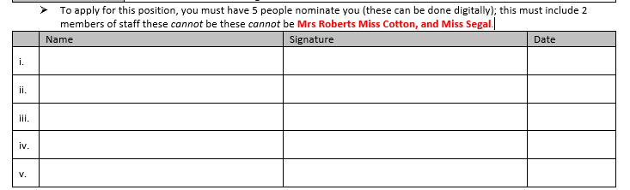
Prefect Applications

Slide 15
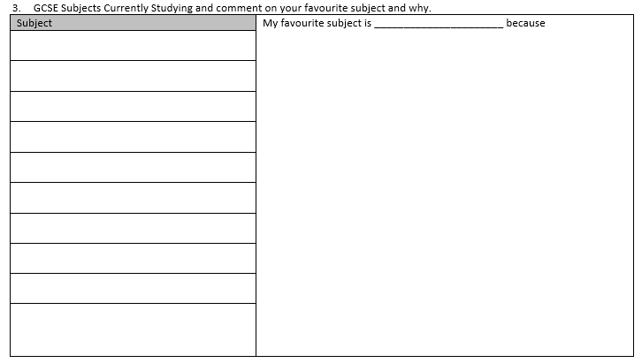
Prefect Applications

Slide 16
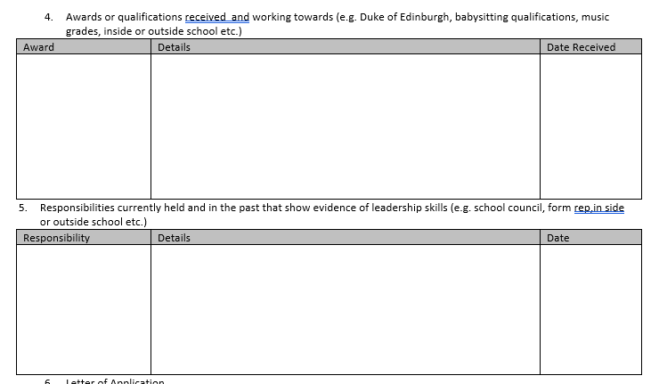
Prefect Applications

Slide 17
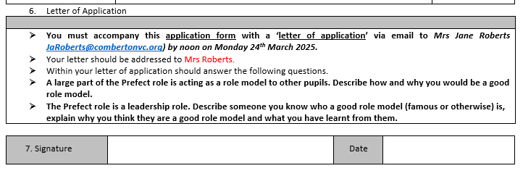
Prefect Applications

Slide 18
Prefect Applications
Applications can be found on
Website in the Year 10 area
Tutors, Mrs Roberts and Miss Cotton
Mrs Jane Roberts JaRoberts@combertonvc.org
Miss Segal msegal@combertonvc.org
Paper and Digital Copies Available

Slide 19
Prefect Application Process
Deadline for applications: Thursday 20th April at noon Application and Letter to Mrs Roberts emailed to Mrs Jane Roberts JaRoberts@combertonvc.org
For those who have applied for the Head Prefect team, reapplying will not be necessary, but you need to contact Mrs Jane Roberts JaRoberts@combertonvc.org to say if you would still like to be consider and what roles you would like to be considered for.
Notes:
Charlie
Shaarah

